Slide 1

NETWORK INTRUSION
DETECTION SYSTEM
DEEPTHI.I 22011103010
MEERA VANATHI.M 22011103028
THAVAMITHA.A.M 22011103060
MENTOR – DR.S.Vidhusha

Slide 2
NETWORK INTRUSION
DETECTION SYSTEM
PROBLEM & SOLUTION
DEEPTHI.I 22011103010
MEERA VANATHI.M 22011103028
THAVAMITHA.A.M 22011103060
MENTOR – DR.S.Vidhusha
TECH STACK
RESULT & INFERENCE
FUTURE ADVANCEMENTS

Slide 3
PROBLEM & SOLUTION
In today's digital landscape, the surge in complex cybersecurity threats like malware, ransomware, data breaches, and denial-of-service attacks demands robust protection.
Network Intrusion Detection Systems (NIDS) play a pivotal role. They monitor real-time network traffic, swiftly detecting and alerting to intrusions and threats. NIDS is adaptable, utilizing anomaly and signature-based detection, and seamlessly integrates with existing security systems, reducing false alarms and ensuring regulatory compliance.
TECH STACK
RESULT & INFERENCE
FUTURE ADVANCEMENTS

Slide 4
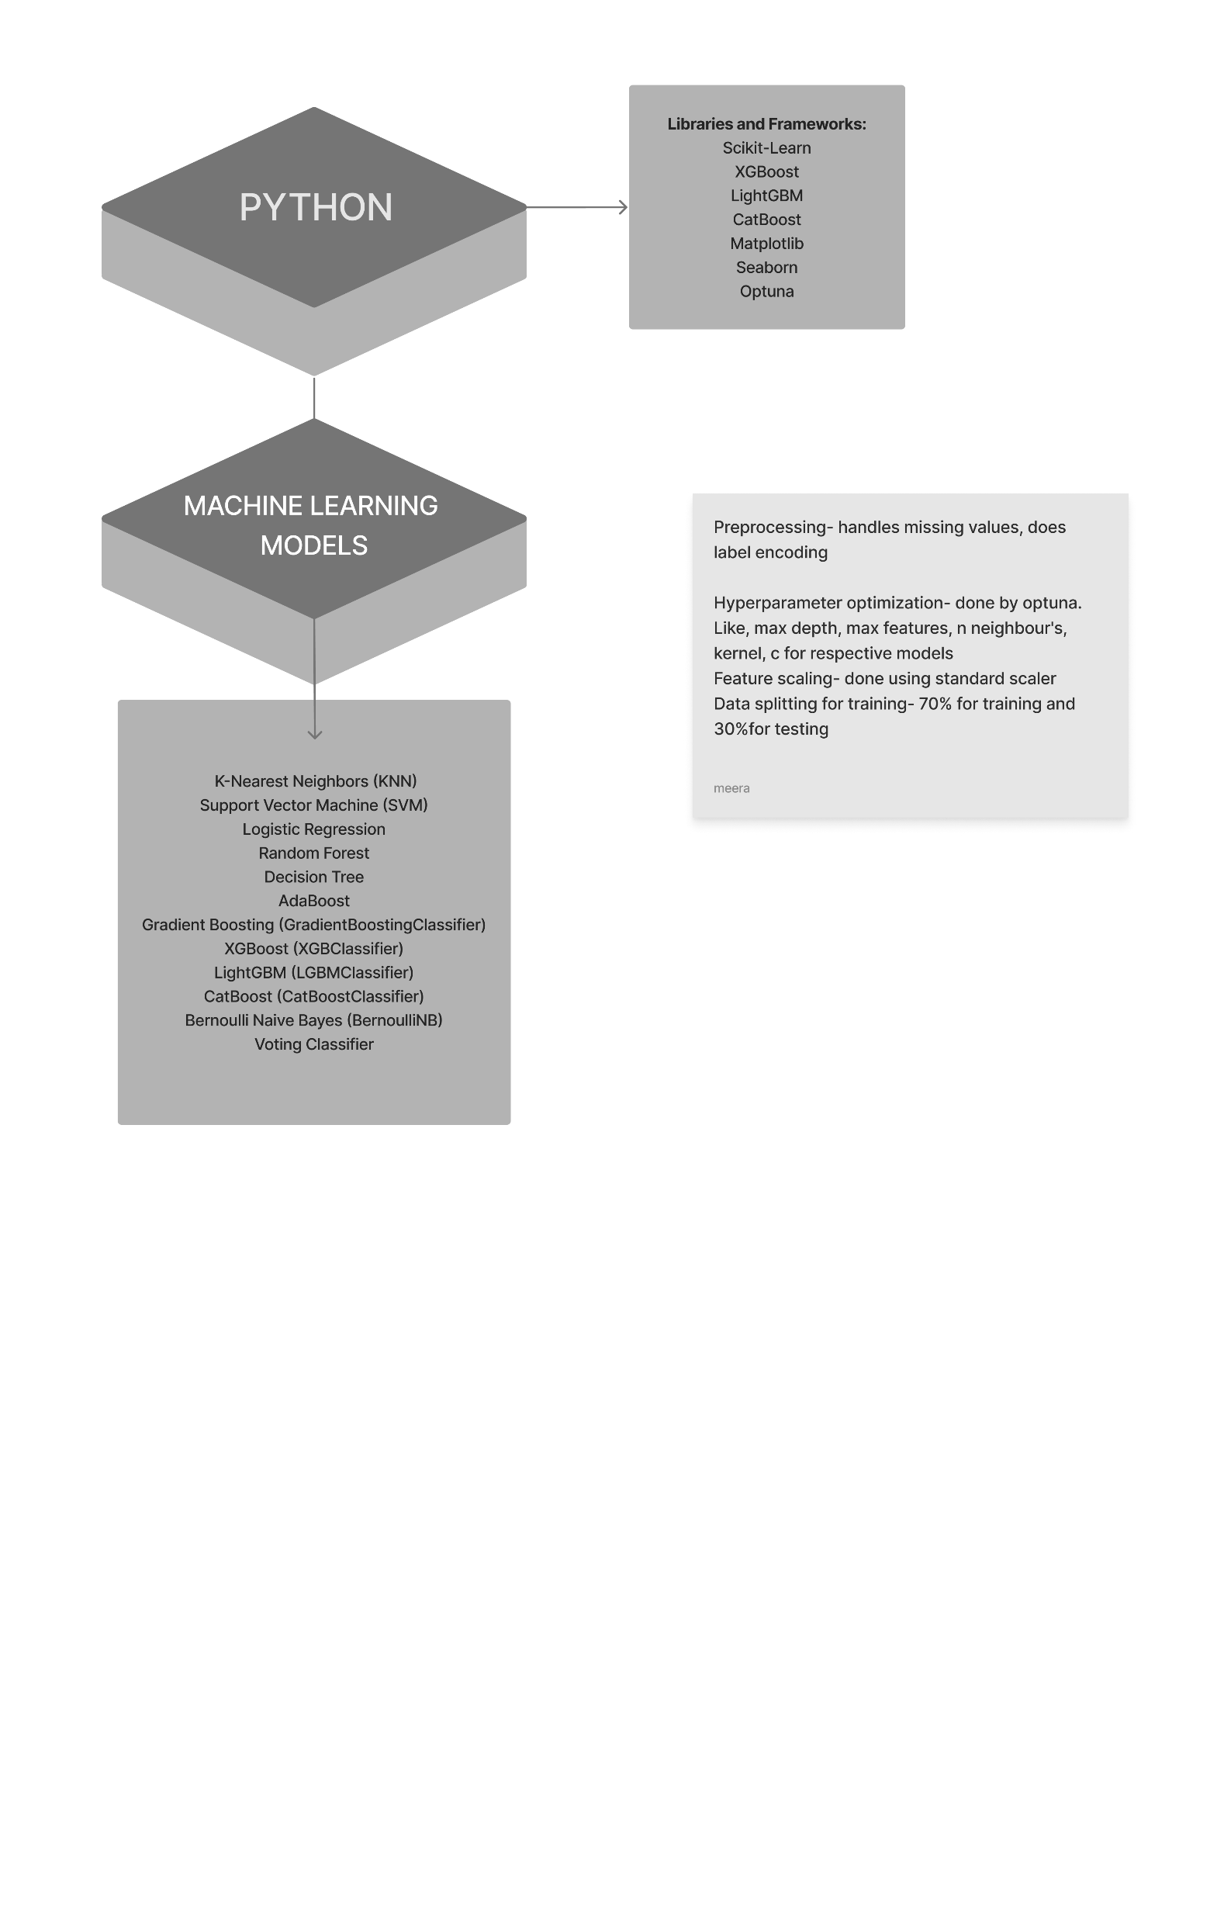
PROBLEM & SOLUTION
In today's digital landscape, the surge in complex cybersecurity threats like malware, ransomware, data breaches, and denial-of-service attacks demands robust protection.
Network Intrusion Detection Systems (NIDS) play a pivotal role. They monitor real-time network traffic, swiftly detecting and alerting to intrusions and threats. NIDS is adaptable, utilizing anomaly and signature-based detection, and seamlessly integrates with existing security systems, reducing false alarms and ensuring regulatory compliance.
RESULT & INFERENCE
TECH STACK
FUTURE ADVANCEMENTS

Slide 5
PROBLEM & SOLUTION
In today's digital landscape, the surge in complex cybersecurity threats like malware, ransomware, data breaches, and denial-of-service attacks demands robust protection.
Network Intrusion Detection Systems (NIDS) play a pivotal role. They monitor real-time network traffic, swiftly detecting and alerting to intrusions and threats. NIDS is adaptable, utilizing anomaly and signature-based detection, and seamlessly integrates with existing security systems, reducing false alarms and ensuring regulatory compliance.
TECH STACK
RESULT AND INFERENCE
FUTURE ADVANCEMENTS

Slide 6
PROBLEM & SOLUTION
TECH STACK
RESULT AND INFERENCE
FUTURE ADVANCEMENTS

Slide 7
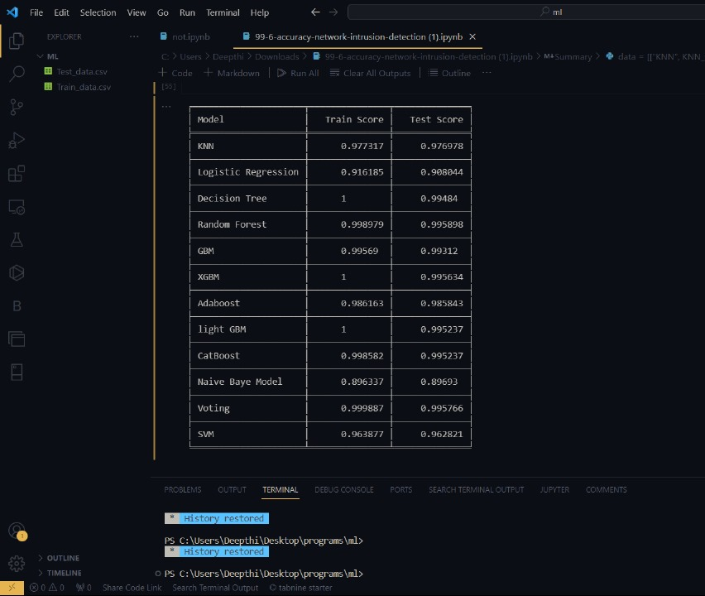
PROBLEM & SOLUTION
TECH STACK
RESULT AND INFERENCE
FUTURE ADVANCEMENTS

Slide 8
PROBLEM & SOLUTION
TECH STACK
RESULT AND INFERENCE
FUTURE ADVANCEMENTS
1. Scalability: Future NIDS solutions are designed for easy scaling to accommodate growing network traffic and increasing network complexity.
2. Zero Trust Security: NIDS aligns with the principles of zero trust security, emphasizing continuous verification and micro-segmentation.
3. Behavior-based Analysis: NIDS evolves to incorporate more sophisticated behavior-based analysis, enabling it to recognize subtle deviations from normal network behavior that may indicate an intrusion.
4. Cloud and IoT Integration: NIDS adapts to monitor and protect increasingly complex and diverse network environments in light of the proliferation of cloud services and the Internet of Things (IoT).

Slide 9
PROBLEM & SOLUTION
1. Scalability: Future NIDS solutions are designed for easy scaling to accommodate growing network traffic and increasing network complexity.
2. Zero Trust Security: NIDS aligns with the principles of zero trust security, emphasizing continuous verification and micro-segmentation.
3. Behavior-based Analysis: NIDS evolves to incorporate more sophisticated behavior-based analysis, enabling it to recognize subtle deviations from normal network behavior that may indicate an intrusion.
4. Cloud and IoT Integration: NIDS adapts to monitor and protect increasingly complex and diverse network environments in light of the proliferation of cloud services and the Internet of Things (IoT).
RESULT AND INFERENCE
TECH STACK
FUTURE ADVANCEMENTS

